Slide 1
*ORATURE IN AFRICA (*oral literary arts)
“In the moment of crisis, the wise build bridges and foolish build dams.”
– Nigerian proverb

Slide 2
African literary arts
Oral traditions
Written or visual traditions
Folk tales
Songs
Poetry
Prayers
Epics (specialists: Griots who recite longer prose)
Story telling by elders
Proverbs
Riddles
Symbolic communication
Novels
Poems / Volumes of poetry
Short stories
Plays (drama) by African authors with African themes and topics

Slide 3
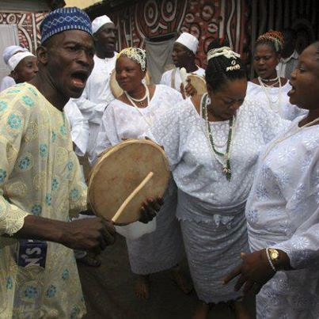
Unwritten literature
Oral Traditions (Orature)
Live Performance is an essential feature, relies on a performer; there is no other way it can be realized.
Depends on repeated performances for its existence.
The delivery or performance is as important as what it says
Expressiveness of tone, gesture, facial expression, dramatic pause, humor, etc. enhance the impact of the message.
Notes:
Image: http://sphotos-a.xx.fbcdn.net/hphotos-ash4/c99.0.403.403/p403x403/418912_277599675679361_152399753_n.jpg

Slide 4
African Storytelling
Many stories were never written down, until recently.
So African people have used oral literature to record their history, culture, customs, and social values.
Through repetition, stories, proverbs, folktales were passed from generation to generation.
A story’s survival depended on the memories of the new generation.

Slide 5
African oral literature is often a communal activity
Traditional African tales constantly change and adapt to current happenings in the community.
Like performers, sometimes story tellers had music, dance and/or songs to their tales.
Each time storytellers perform, they may add new twists or elements.

Slide 6
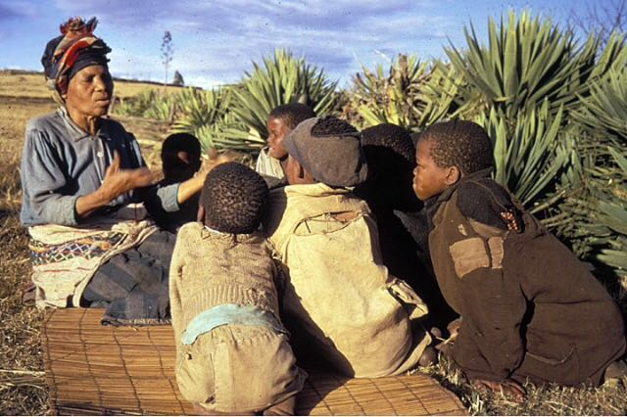
South Africa: Story Telling / folktales in small, intimate settings
Women, grandmothers are typically the story tellers in South Africa.
Primary Goal: To educate or instruct the young (and old alike)
Meant also to entertain
Notes:
Ndebele Folk Tales – told by a grandmother.
http://www.youtube.com/watch?v=n7Iva6WU7dI
http://2.bp.blogspot.com/-1gPDJZ5nwmA/T4XRZoJ4O-I/AAAAAAAABaY/33y5vJtSxGA/s1600/Ndebele%2Bwoman%252C%

Slide 7
Folktales
Usually have animals & humans, animals serve examples or as helpers to humans in time of need.
Often told in the evening, * the time of spirits
Ndebele Folk Tales – told by an Ndebele grandmother. (5:00 mins)
http://www.youtube.com/watch?v=n7Iva6WU7dI

Slide 8
With large communal gatherings
The audience is a part of the experience
The audience is an important part of the African Story telling experience.
They may repeat certain phrases in a call-and answer format with the storyteller, or join in with the song and dance of the story.
Depending on how the performer is doing, they may shout out praise or criticism during the tale.

Slide 9
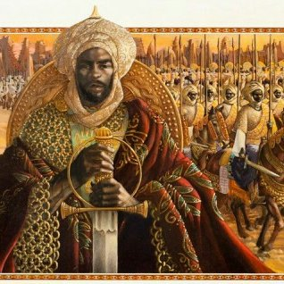
Epic poetry
The most well known example is
Sundiata (Lion King of Mali)
Sundiata Keita 7:14 mins.
https://www.youtube.com/watch?v=s8BXzkeuSdc

Slide 10
Relationship between Sundiata the old epic of Mali and the Lion King
Sundiata Keita 7:14 mins.
https://www.youtube.com/watch?v=s8BXzkeuSdc
Sundiata as told by The Lion King
https://www.youtube.com/watch?v=cnv-r2fN3CY
Kayla Jefferson
Published on Sep 26, 2013
The Sunjata Story - Glimpse of a Mande Epic 20:00 mins
https://www.youtube.com/watch?v=yOS78ul1_rA

Slide 11
Proverbs
Short saying, well-known by society
Expresses a truth
Offers a guide to good conduct
Sometimes refers to animals but commenting on human life
“Even an ant can hurt an elephant” – South African proverb
“If there were no elephants in the jungle, the buffalo would be a great animal.” - Ghanaian proverb

Slide 12
Social Power of proverbs
Use of Metaphor to conceal deeper meanings
Used to address someone or
Criticize an individual indirectly or
Comment on government
Often warns against foolish acts
Element of rhythm when spoken aloud
Read aloud---
“In the moment of crisis, the wise build bridges and foolish build dams.” – Nigerian proverb

Slide 13
Proverbs as a verbal art
Competence with proverbs depends on…
Face-to-face communication
Being familiar with various proverbs,
relies on memory,
Effective application: choosing the right proverb for particular situations
A recitation that carries expressive impact

